Slide 1
Machine Learning Project
UR3 CobotOps
Member : taekmyung kim , Hyunsung Yoo, Dohyun Namgung

Slide 2
Table of
Contents
01
Introduction to Dataset
02
Problem Definition
03
Preprocessing & Machine Leaning
04
Result

Slide 3
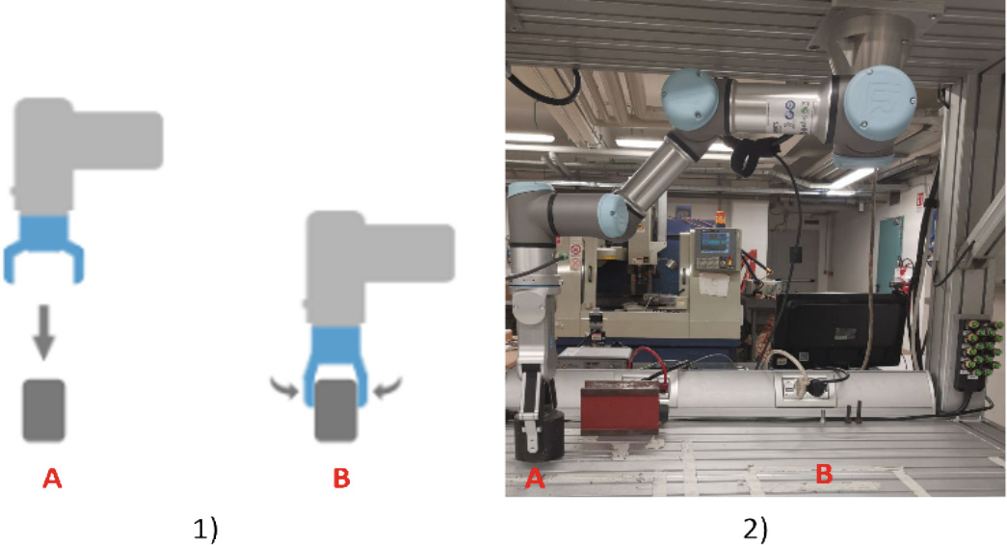
1. Introduction to Dataset

Slide 4
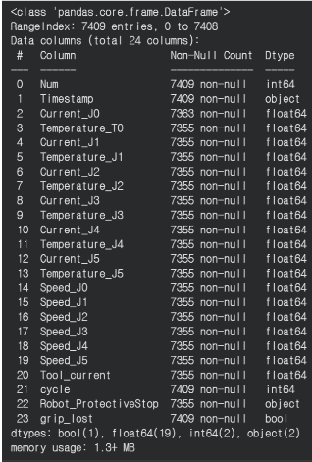
1. Introduction to Dataset
Dataset review
7409 X 24
Current_J0~J5
Temperature_J0~J5
Speed_J0~J5
Tool_current
Robot_ProtectiveStop
grip_lost

Slide 5
2. Problem Definition
Purpose
01
Regression
Tool Current Prediction
02
Classification
System Failure Prediction
03
Clustering
Operating State Discovery

Slide 6
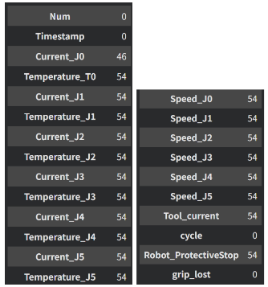
3. Preprocessing
df.isNull().sum()
8:2
Standard Scaling

Slide 7
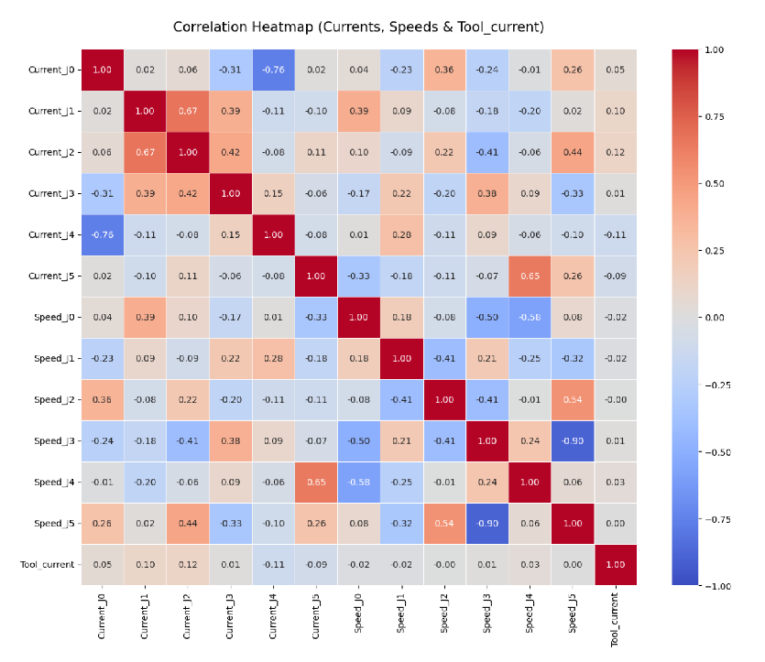
3. Regression – Tool Current Prediction
EDA

Slide 8
3. Regression – Tool Current Prediction
Result
 | Train R2 | Test R2
Linear Regression | 0.0835 | 0.1047
Polynomial | 0.2786 | 0.2340
Ridge | 0.2499 | 0.2298
Lasso | 0.2492 | 0.2322
ElasticNet | 0.2495 | 0.2334
Decision Tree | 0.6397 | 0.4697
Random Forest | 0.8211 | 0.5848
KNN(K=8) | 1.0000 | 0.5219
Linear Regression,
Decision Tree,
Random Forest,
KNN,

Slide 9
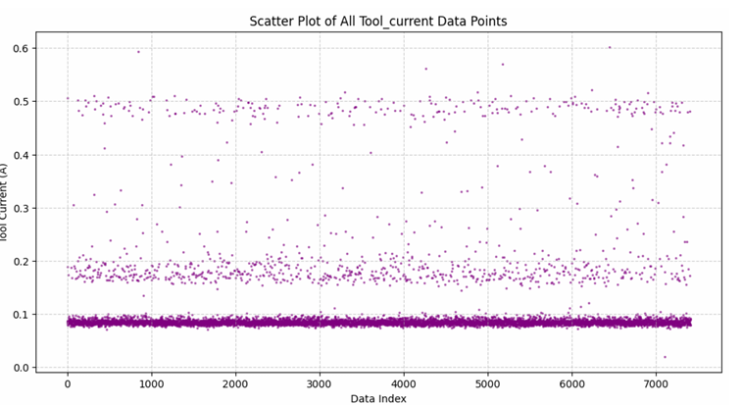
3. Regression – Tool Current Prediction
Result
The scatter plot below illustrates the overall distribution of Tool Current values.
Since regression models attempt to minimize prediction error by estimating intermediate values, prediction inaccuracies occur because the actual Tool Current is concentrated in several discrete operating states rather than continuously distributed.

Slide 10
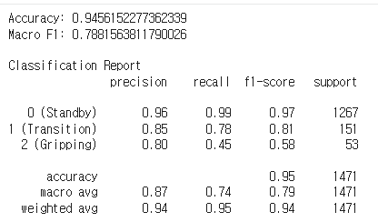
3. Regression – Tool Current Prediction
Result
It was confirmed that there was a clear association between joint data and tool current. However, it was concluded that it was much more useful to approach the classification problem of matching the gripper's current operating state rather than the regression of successive numbers.
As a result of learning with the classification models Random Forest on the same subject, the F1-score recorded 0.57, respectively

Slide 11
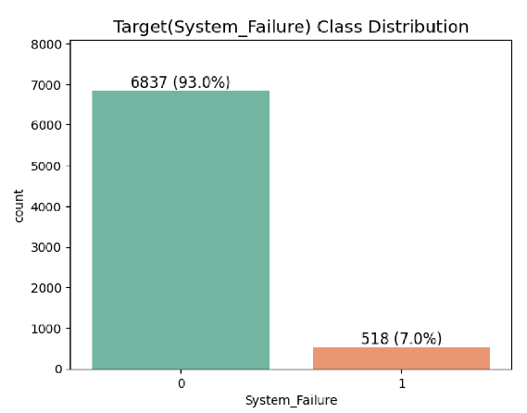
3. Classification – System Failure Prediction
EDA
Make System Failure Label
System Failure = Protective Stop = 1 or grip lost = 1
Normal 93%, Abnormal 7%
Need SMOTE

Slide 12
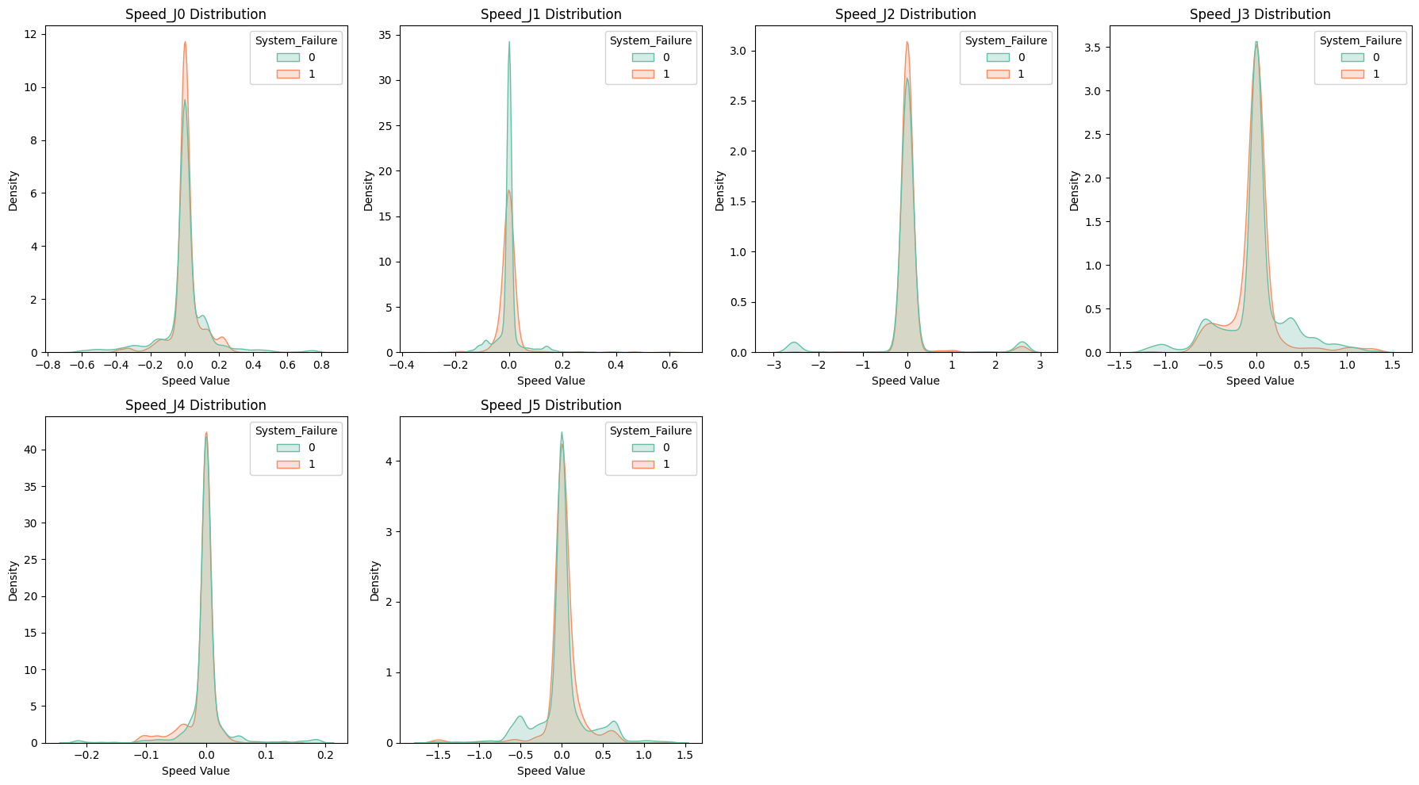
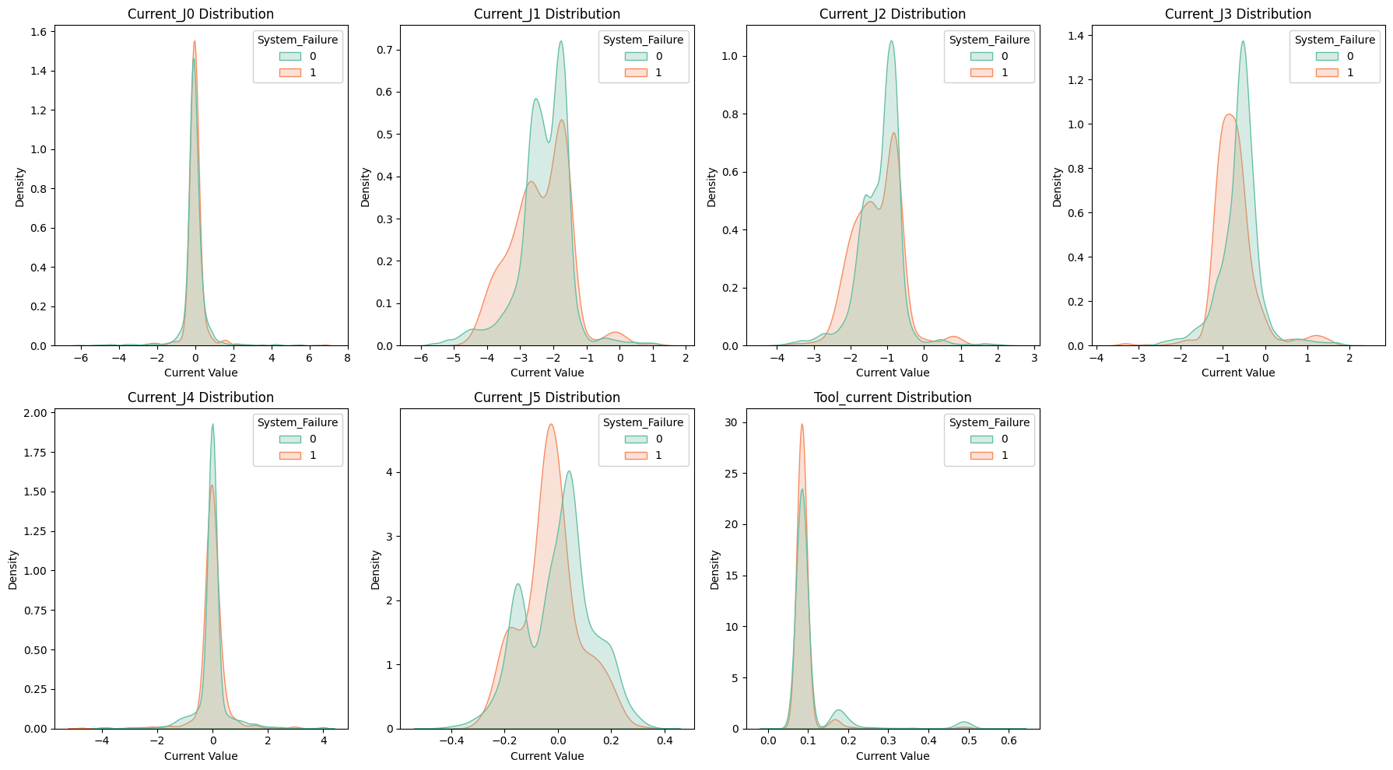
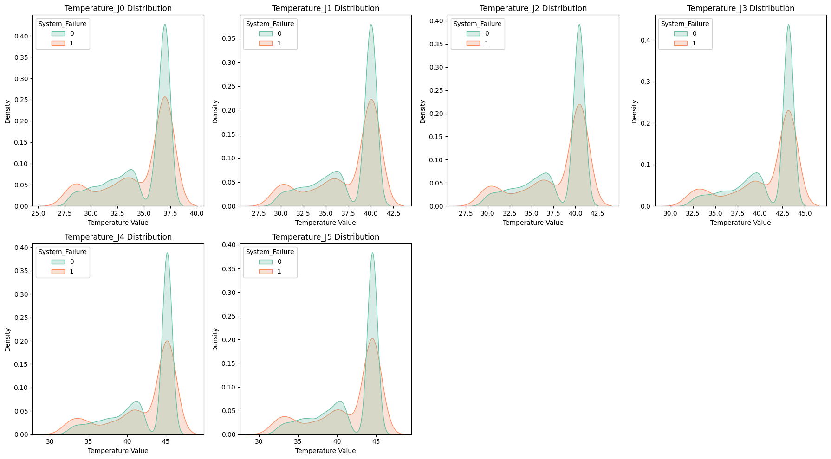
3. Classification – System Failure Prediction
EDA

Slide 13
3. Classification – System Failure Prediction
Result
 | F1-score | Recall | Precision
Logistic Regression | 0.24 | 0.75 | 0.14
SVM | 0.51 | 0.75 | 0.39
Decision Tree | 0.47 | 0.62 | 0.38
Random Forest | 0.63 | 0.65 | 0.61
KNN | 0.50 | 0.66 | 0.40

Slide 14
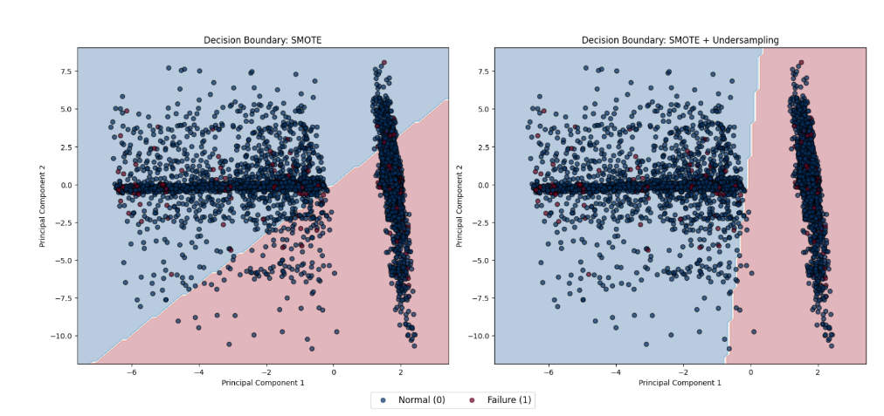
3. Classification – System Failure Prediction
Result – Logistic Regression
Blue dot: normal, red dot: failure
Left: SMOTE, right: SMOTE + undersampling
Failure samples are deeply mixed with normal samples in both cases
The dataset exhibits a non-linearly separable structure
Linear classification is therefore inherently limited

Slide 15
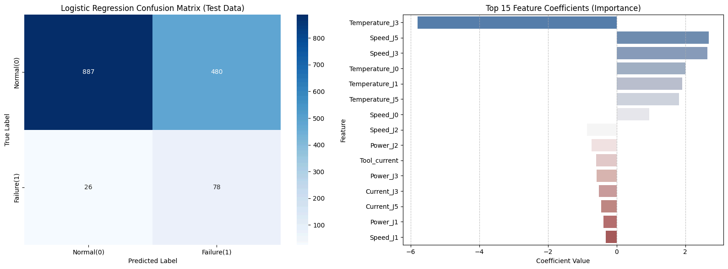
3. Classification – System Failure Prediction
Result – Logistic Regression
TN : 887 FP : 480 FN : 26 TP : 78

Slide 16
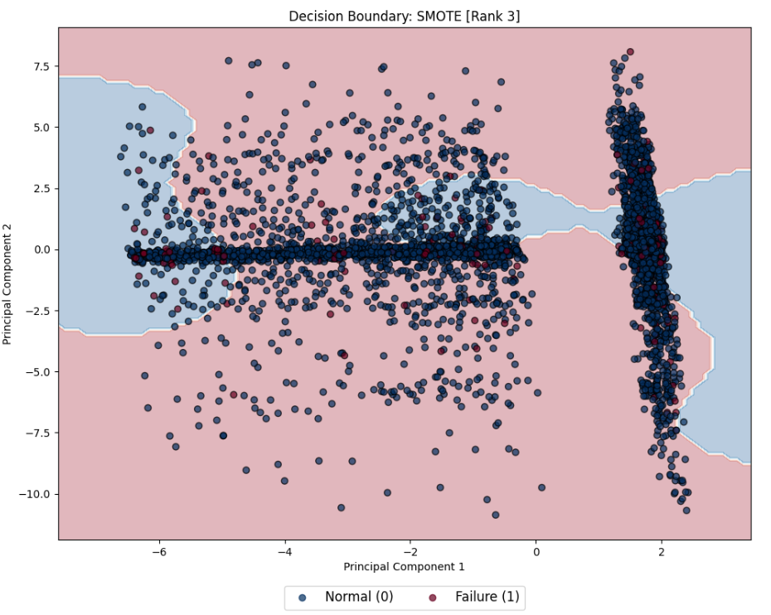
3. Classification – System Failure Prediction
Result – SVM

Slide 17
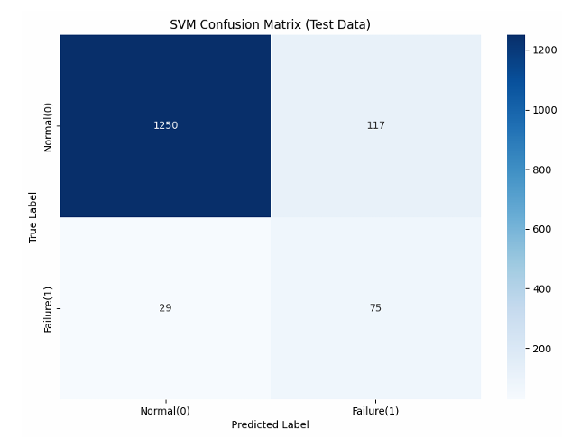
3. Classification – System Failure Prediction
Result – SVM
TN : 1250 FP : 117 FN : 29 TP : 75

Slide 18
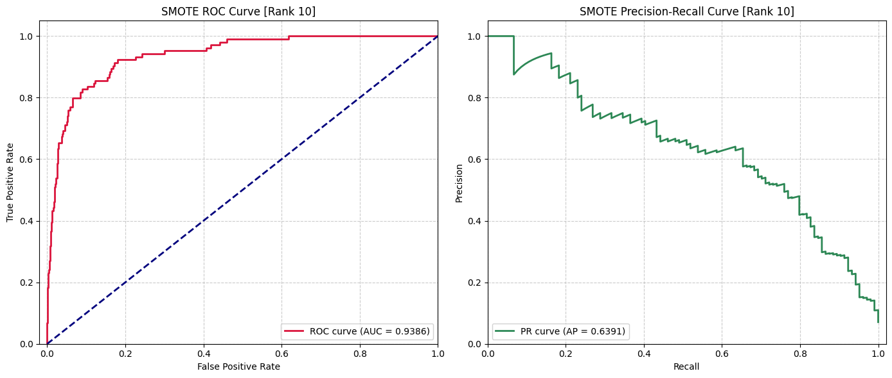
3. Classification – System Failure Prediction
Result – Random Forest
ROC Curve, PR Curve
ROC-AUC 0.938

Slide 19
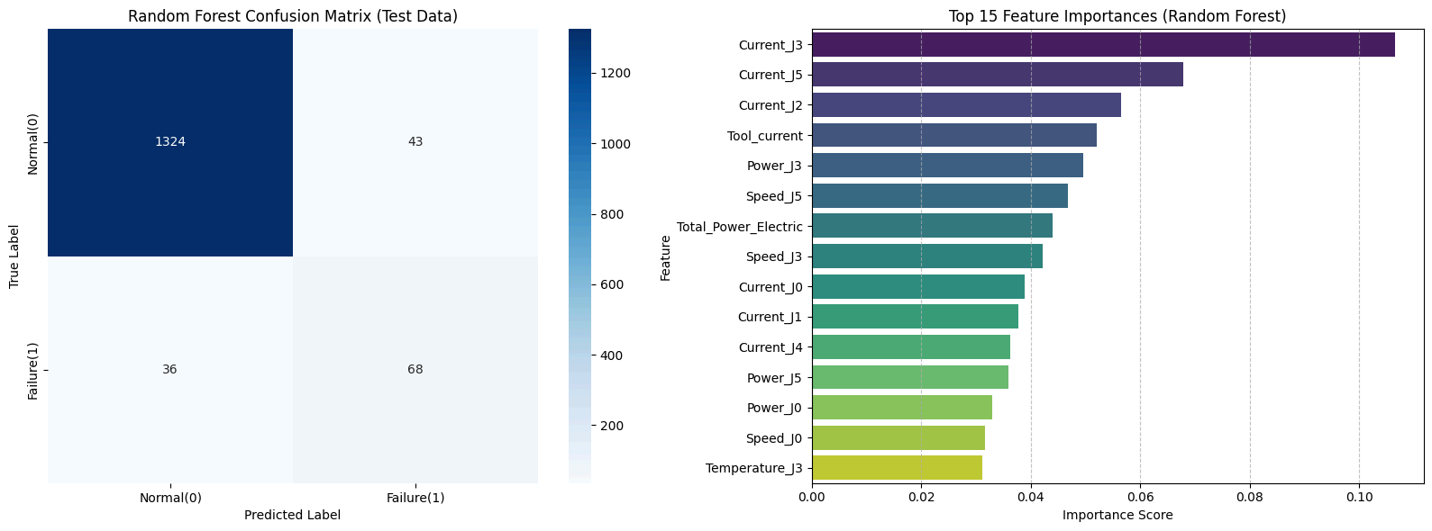
3. Classification – System Failure Prediction
Result – Random Forest
TN : 1324 FP : 43 FN : 36 TP : 68

Slide 20
3. Classification – System Failure Prediction
Result
The dataset exhibited severe class imbalance, with approximately 93% normal samples and 7% failure samples, making Accuracy alone insufficient for reliable evaluation.
To address this issue, SMOTE was applied to the training data, and model performance was evaluated using F1-score, Recall, Precision, and ROC-AUC.
Analysis of the Logistic Regression decision boundary revealed that failure samples were heavily embedded within normal samples, indicating that the data is not linearly separable.
Therefore, the relationship between the input features and system failures is likely to involve complex non-linear patterns rather than simple linear relationships.
Non-linear models such as Random Forest consistently outperformed linear models, with Random Forest demonstrating the most stable generalization performance.

Slide 21
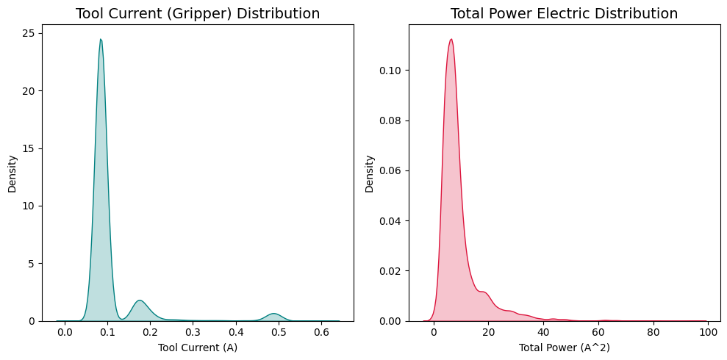
3. Clustering – Operating State Discovery
EDA
Tool Current showed three distinct peaks around 0.08A, 0.18A, and 0.49A.
Tool Current showed 3 distinct peaks. However, clustering on a single variable is merely thresholding, not meaningful multi-dimensional analysis.

Slide 22
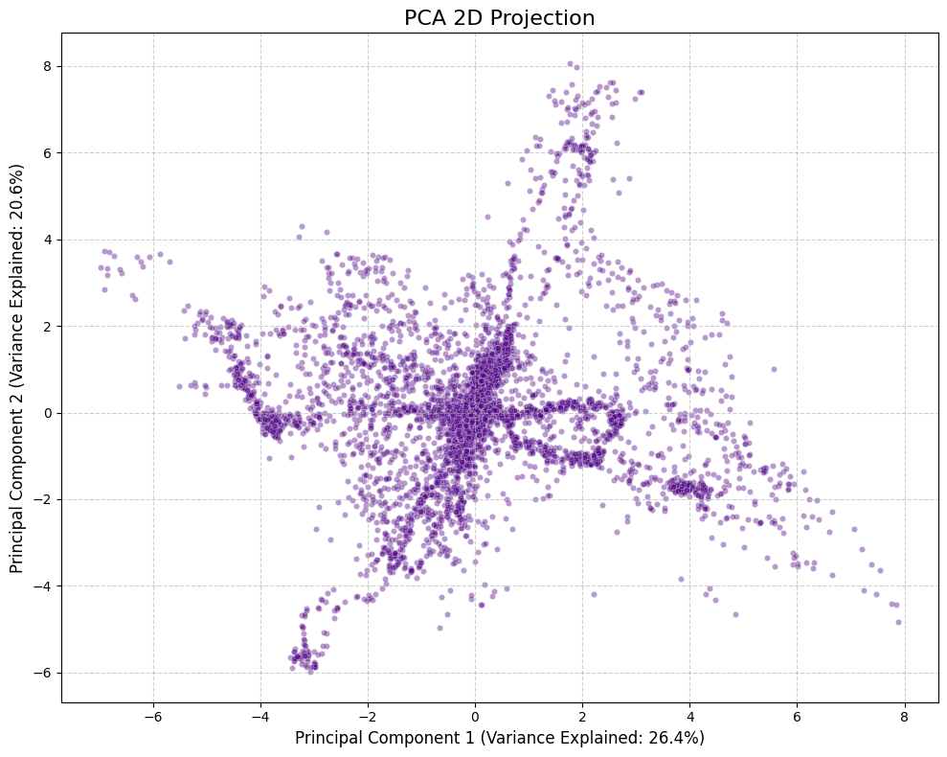
3. Clustering – operating State Discovery
EDA
PCA was used to visualize the overall structure of the data.
Multiple branches and dense regions were observed, indicating potential cluster structures.

Slide 23
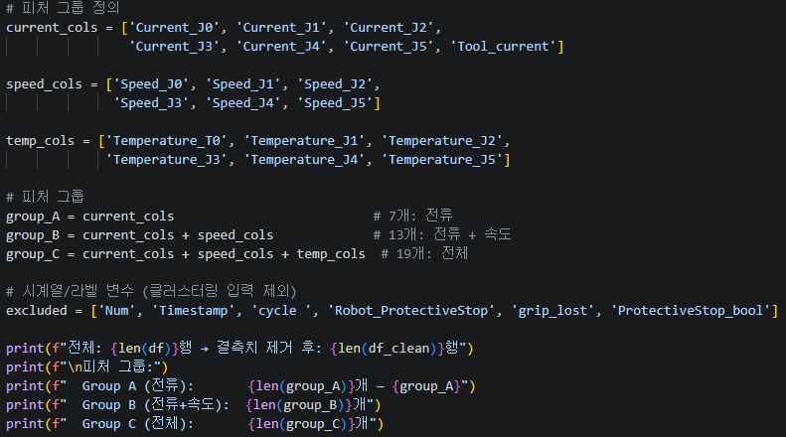
3. Clustering – Operating State Discovery
Result
Feature Groups:
• Group A: Current (7 features) — electrical load
• Group B: Current + Speed (13 features) — dynamic state
• Group C: All 19 features — comprehensive state

Slide 24
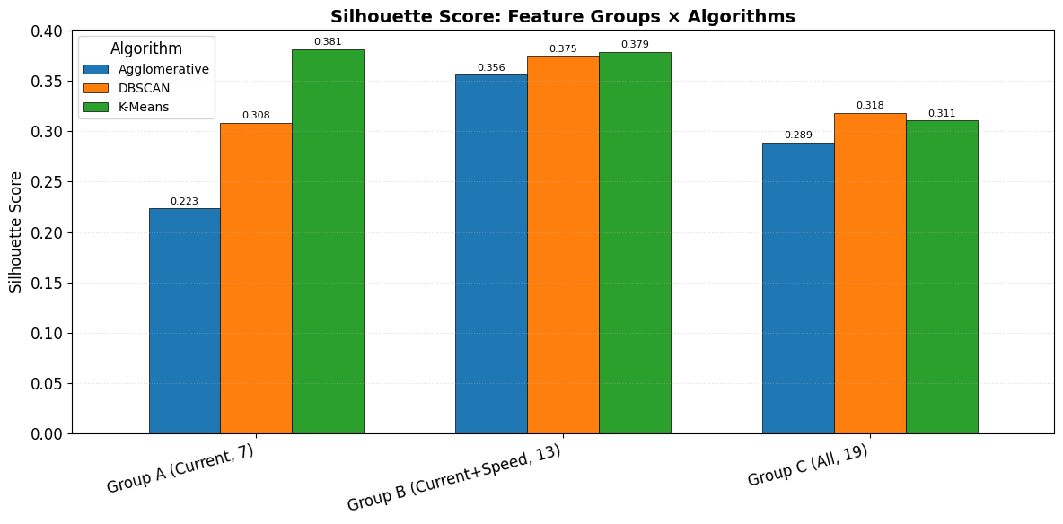
3. Clustering – Operating State Discovery
Result

Slide 25
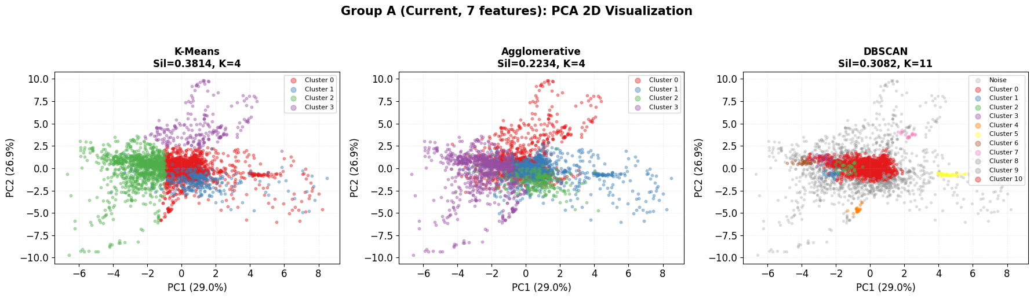
3. Clustering – Operating State Discovery
Result

Slide 26
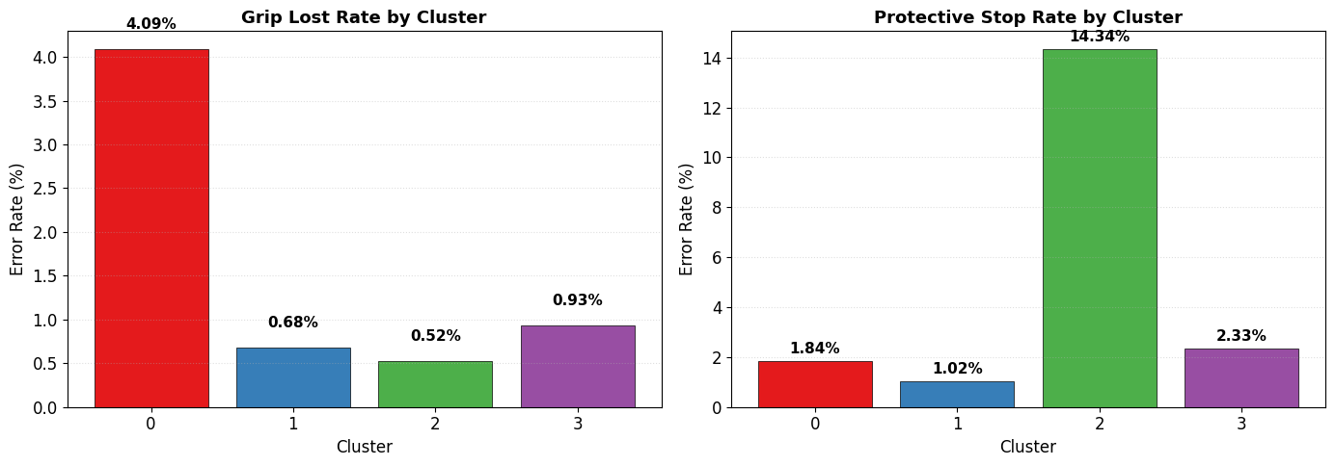
3. Clustering – Operating State Discovery
Result

Slide 27
3. Clustering – Operating State Discovery
Result
1. Single-variable (Tool Current) clustering achieved
Silhouette 0.92 but was merely thresholding.
2. Multi-dimensional clustering with 7 current features
discovered 4 distinct operating states (Sil=0.38).
3. Cluster 2 (shoulder/elbow overload) showed 14.34%
Protective Stop rate — 4× the average.
4. K-Means outperformed Agglomerative and DBSCAN for
this dataset's spherical cluster structure.

Slide 28
4. Machine Learning Result
Regression
Joint Current and Speed contained meaningful information about Tool Current.
Tool Current prediction achieved a maximum Test R² of 0.58 using Random Forest.
Classification
System failures were driven by complex non-linear relationships among sensor variables.
System failure prediction achieved a maximum F1-score of 0.63 using Random Forest.
Clustering
Multi-dimensional clustering (7 current features, K-Means, K=4) discovered 4 operating states with Silhouette = 0.38.
The overload state (Cluster 2) concentrated 60% of all Protective Stops, revealing that shoulder/elbow overload is a key trigger for system failures.

Slide 29
EX. REFERENCE
Dataset
https://archive.ics.uci.edu/dataset/963/ur3+cobotops
Paper
https://link.springer.com/chapter/10.1007/978-3-031-63851-0_6

